Slide 1










A UNIVERSITY MANAGEMENT SYSTEM
Mid-tem Innovative Project
Software Engineering (MC310)
Submitted By:
Aiman Siddiqua 2K18/MC/008
Amogh Dhar Diwan 2K18/MC/012

Slide 2
ABOUT THE PROJECT
This project deals with management of Student and Teacher details in a university.
It handles the following functions:
Registration
Attendance Details
Examination Details
Fee Structure and Payment
Other Utilities
The following technology
stacks are used:
Java
Java Swing (GUI)
SQL (Backend)

Slide 3

NOVELTY
The entire University Management System (UMS) is specific for a DTU ERP System. This includes the fee structure and the courses.
All result features were modeled on the basis of own 3rd year subjects.
The entire Attendance Feature was planned and implemented by us.
The UMS includes a feature that can open your Browser, Calculator and Notepad.

Slide 4

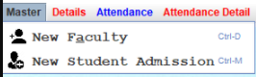
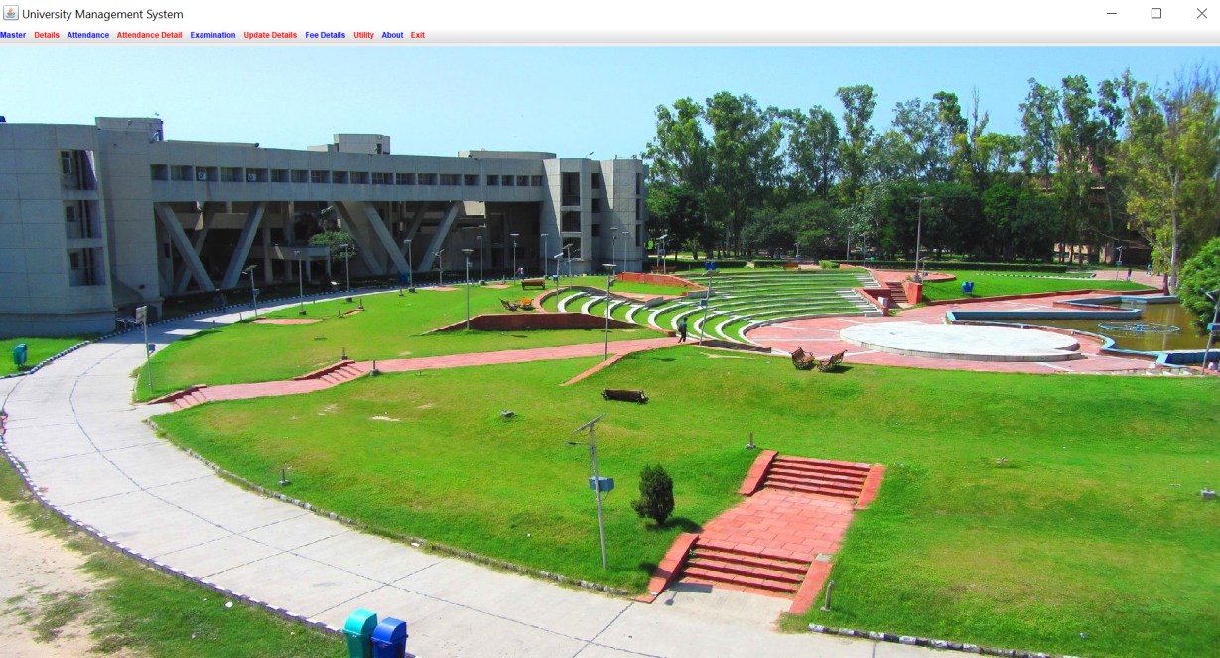
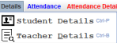
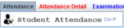
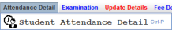
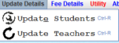
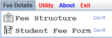
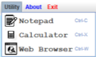
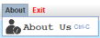
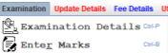
SCREENSHOTS FROM THE PROJECT
THE MAIN SCREEN
All Features offered by the UMS

Slide 5
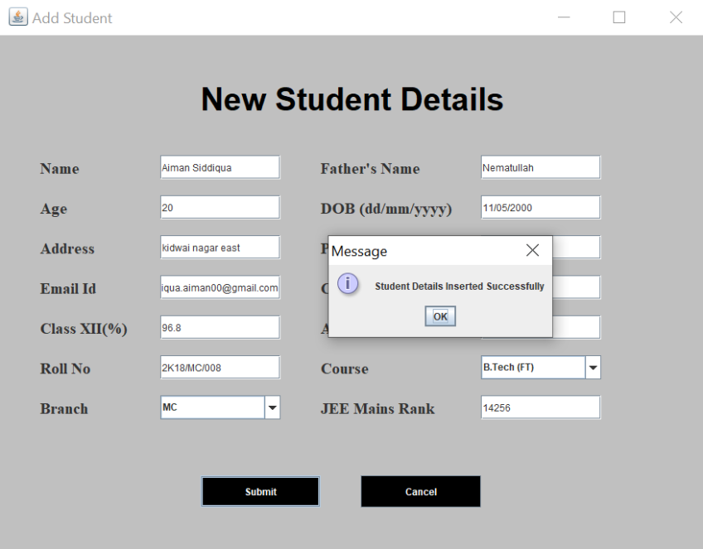
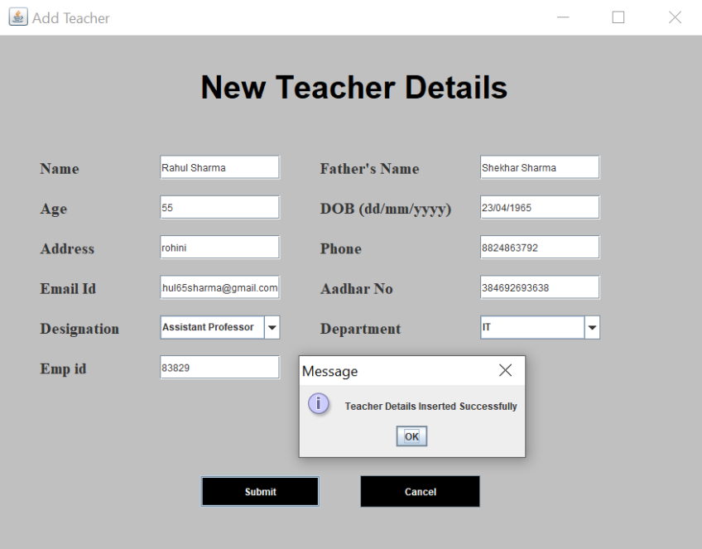

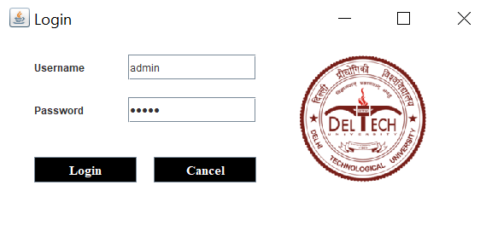
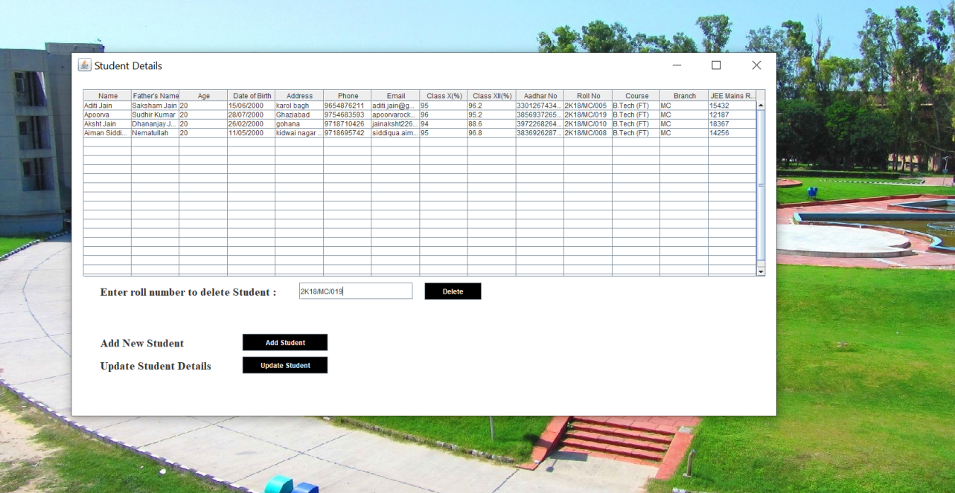
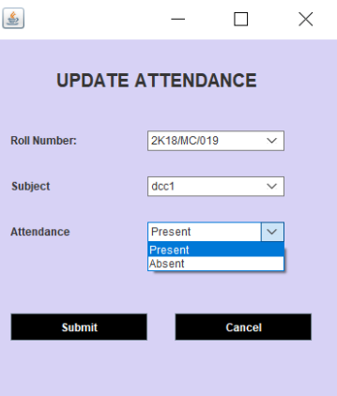
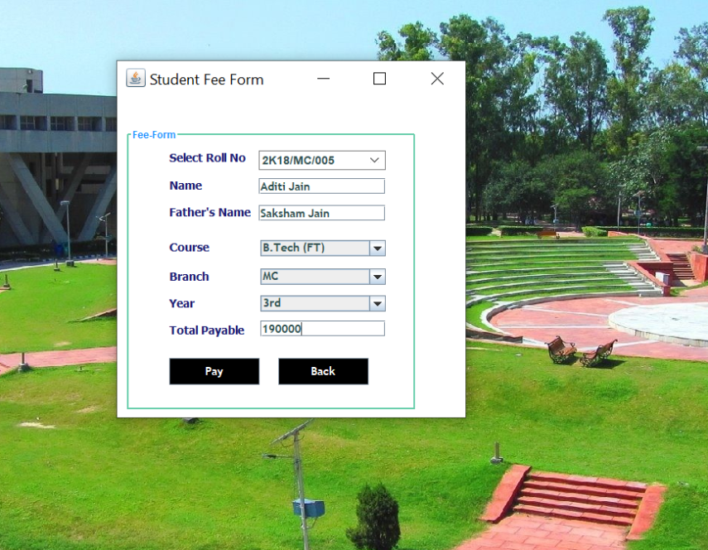
FEATURES
LOGIN SCREEN
STUDENT REGISTRATION
TEACHER REGISTRATION
UPDATE ATTENDANCE
STUDENT DETAILS
STUDENT FEE PAYMENT

Slide 6


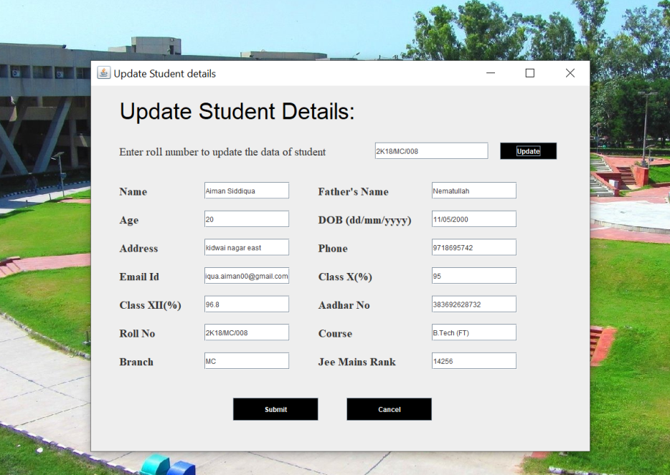
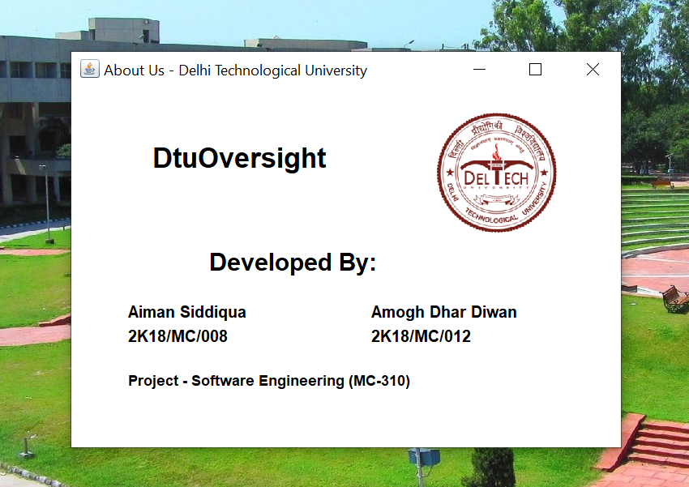
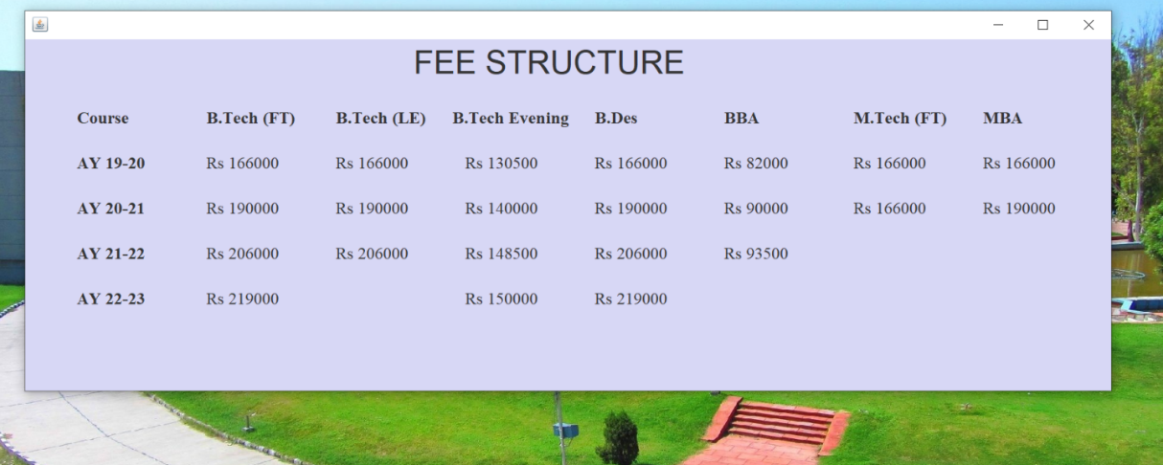
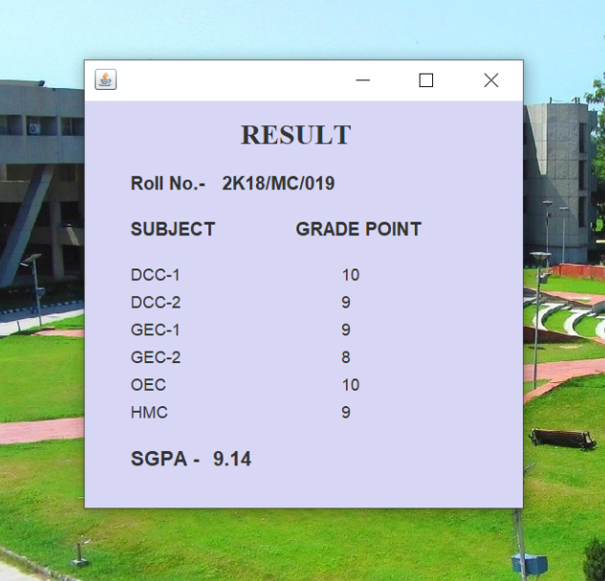
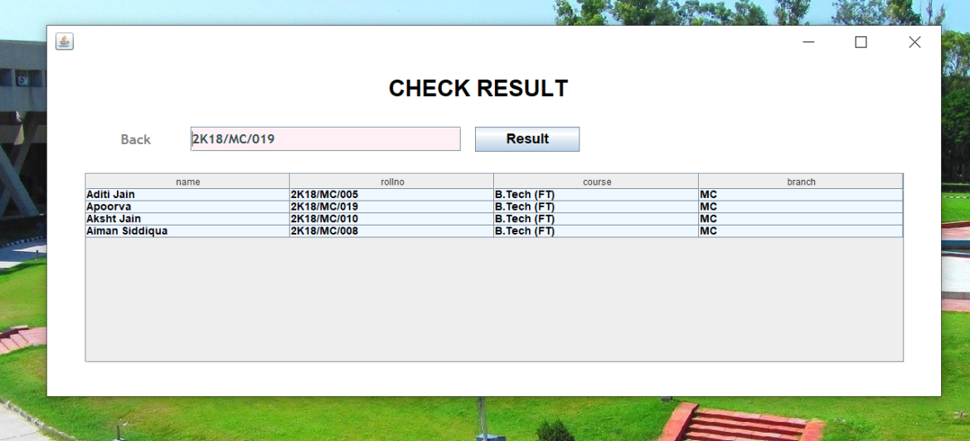
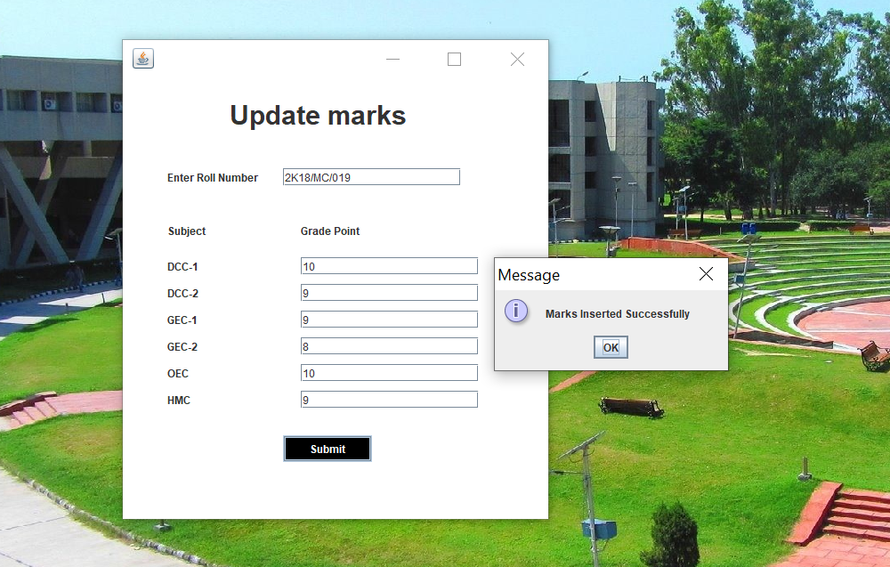


FEATURES
UPDATE STUDENT DETAILS
FEE STRUCTURE
ABOUT US
SHOW RESULT
CHECK RESULT
UPDATE RESULT

Slide 7
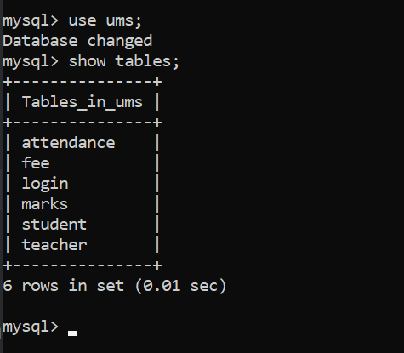
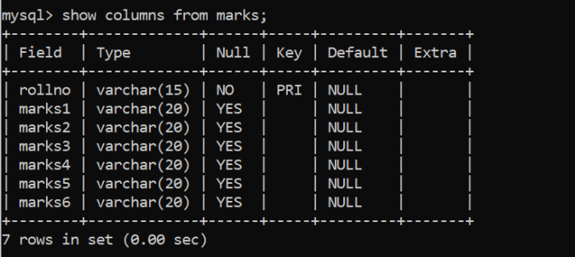

ALL COLUMNS IN MARKS TABLE
(EXAMPLE OF A TABLE IN BACKEND)
ALL TABLES USED IN THE PROJECT
BACKEND (SQL)

